Slide 1


Industry Leading
Email Marketing

Slide 2


Email Marketing
Can Market Location ensure we get the best results in my business sector?
20
Years
Experience
We have 20 years of experience across ALL business sectors.
Each sector requires a specialised approach, with some demanding more from higher security protocols to a trusted sending reputation.
With the valuable knowledge we have obtained over the years, we have perfected our methods to deliver industry leading results no matter the target audience.

Slide 3
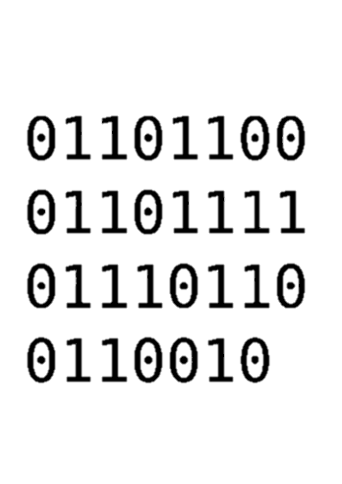
Email Marketing
Only the best data to fuel your email campaigns
Most marketing companies do not provide the data to use in your email campaigns, so they cannot guarantee best performance – Market Location can.
We only use high quality, verified data for our email campaigns.
This is the foundation which enables us to build and achieve industry leading delivery and engagement rates for ALL sectors.
ML DATA

Slide 4




Email Marketing
How we keep our data top quality
Bounced Emails Removed
Verified using AI
Cleansed Email database
Hard bounces are quarantined after just 1 attempt, ensuring reputation and delivery remain high.
Verified by REAL people
We use AI to confirm our emails are accurate, using online resources for confirmation.
Spam Traps, Toxic Emails, Invalid DNS are just a few of the checks we scan our data for regularly to cleanse.
We have an in-house UK call centre that call every business to update and verify our emails are still valid.

Slide 5






Email Marketing
All Domains & IPs managed in-house
Automated Reporting & Tracking API
Real-time tracking using our API to pull your leads into your CRM.
We have total control from front to back end which is critical for achieving top delivery.
In-House Creative Team
Automated Campaigns
Streamline the process from concept to delivery. No third-party delays.
Curate healthy engagement with relevant content, using automated triggers.
Managed by people
Always Compliant
You will have a dedicated account manager to contact directly. We can support your needs and share our wealth of experience.
You can be confident we cover all bases when it comes to your campaigns and UK Compliance regulations.

Slide 6





High Engagement
Email Marketing
93% Delivery
20m users actively engaging with our email content every year.
We achieve high delivery across all campaigns and sectors, beating the industry standards.
10,000+ Campaigns
300+ Domains
We create and maintain custom domains for every client, giving you a dedicated setup.
Why are we best in-class?
We see all 10k campaigns through start to finish, from strategy and creative to end delivery management.
120m sends each year
0.2% Bounce Rates
Infrastructure in place for
high-capacity bulk sends.
We remove any hard bounces and quarantine soft bounces across all clients.

Slide 7
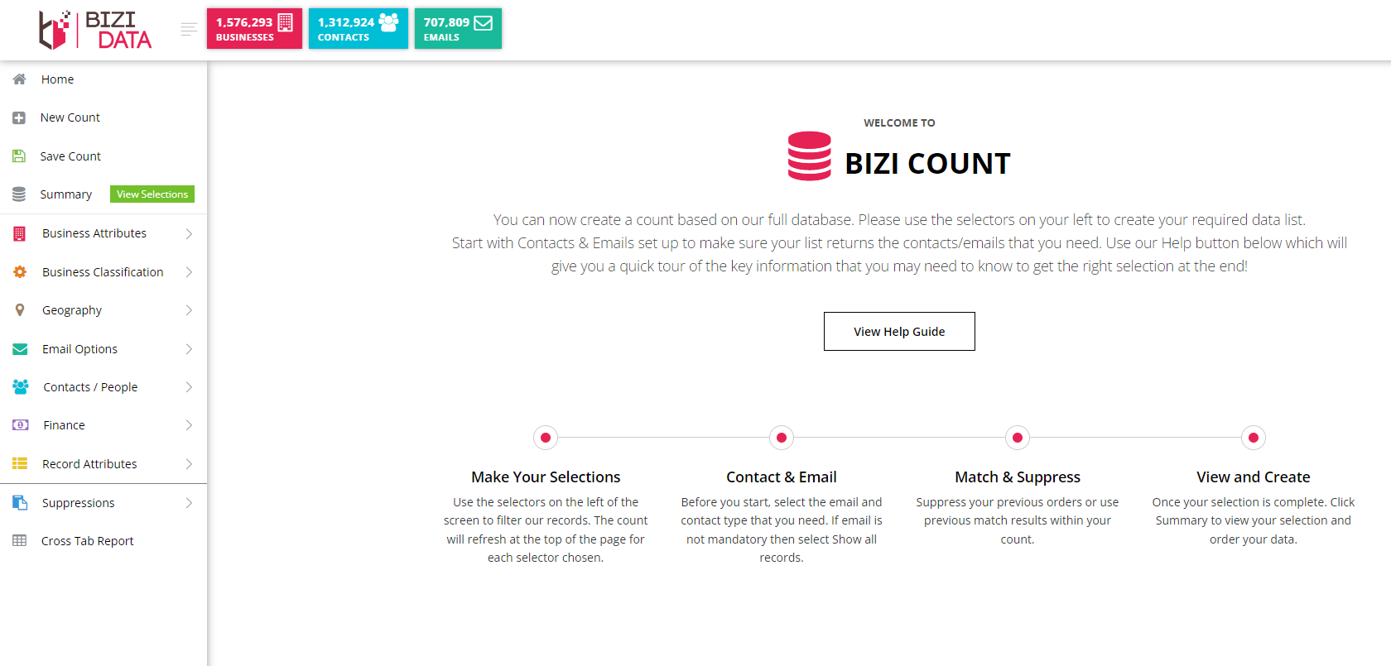
In-house data platform
We have built our own data platform, so you get access to the data you need with full support and no delays.
With powerful matching and selection tools, you have our entire UK database at your fingertips.
04
03
Make Your Selections
Contact & Email
Match & Enhance
Use complex selections to filter down only relevant businesses.
Only want records with telephone numbers or emails? Our Count platform allows you to dynamically tweak criteria on the go.
Match your data against ours, only take the records you need or enhance your existing records.

Slide 8
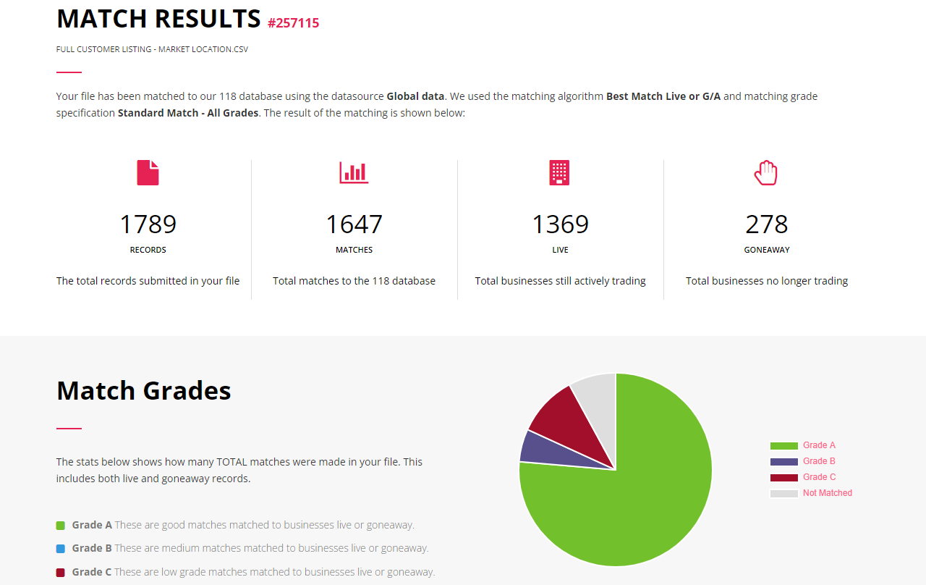
Email Marketing
Match & Analyse your data
See an intuitive overview of your data.
With our powerful matching software, you can target the areas in your data with less integrity and enhance with our own high quality records.
02
04
Is your data GDPR compliant?
We can flag any records that are out of date or inaccurate, ensuring you comply with GDPR guidelines.
Scan for CTPS/TPS
Validate your data to ensure you are not contacting registered individuals or companies.

